Slide 1
MongoDB Replica Set Tutorial
Step by Step Replication Example
Group 9
Shishir Umesh
Nishanth Kumar

Slide 2
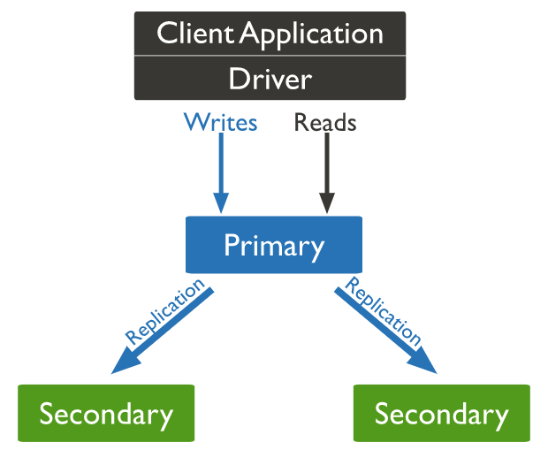
What is Replication?

Slide 3
Why Replication?
It is the process of ensuring that the same data is available on more than one MongoDB Server.
Replication provides :
Redundancy
Increases data availability
With multiple copies of data on different database servers, replication provides a level of fault tolerance against the loss of a single database server.
Increases data locality for distributed applications.
Increase read capacity and load balancing
Equal distribution of read requests across multiple servers to improve CPU utilization
Data Recovery and Backup

Slide 4
Tutorial on creating a Replica Set

Slide 5
Process Overview
Initiate Primary Configuration
Add Secondary Servers
Removing Secondary Servers
Checking Status

Slide 6
First Server Creation
mongod --dbpath <Path to store data> --logpath <Path to log> --port <port number>
--replSet <Replica Set Name>

Slide 7
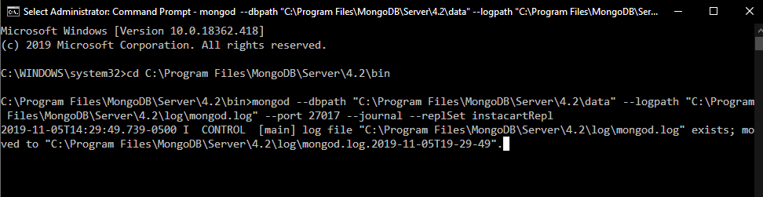
First Server Started

Slide 8
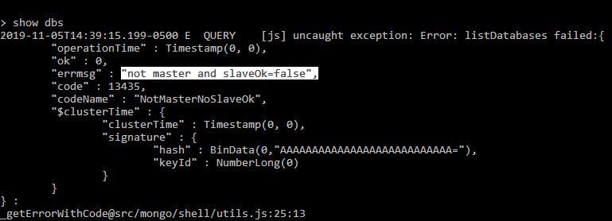
Not yet a Primary Server.

Slide 9
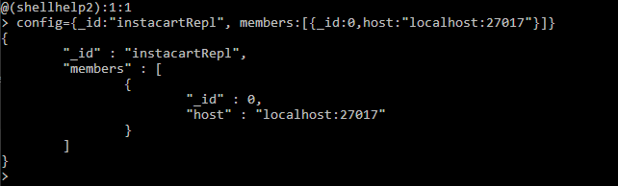
Initiate Configuration - create config

Slide 10
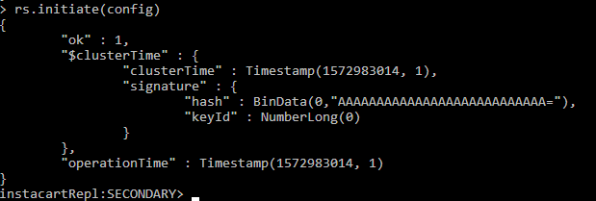
Initiate Configuration - rs.initiate()

Slide 11
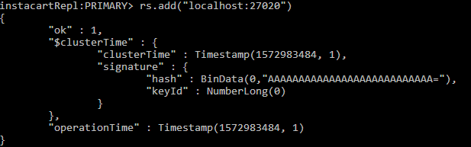
2. Add secondary member

Slide 12
2. Add secondary member

Slide 13
2. Add secondary member

Slide 14
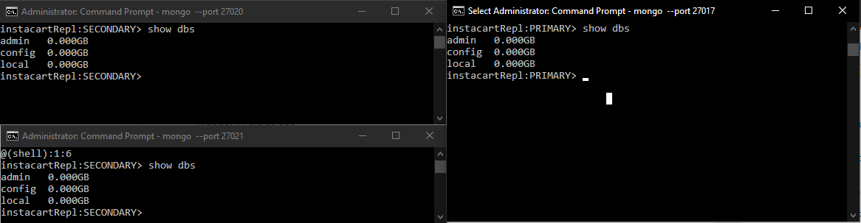
Check Replication

Slide 15
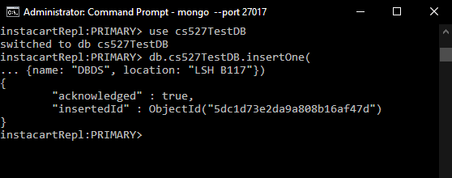
Check Replication

Slide 16
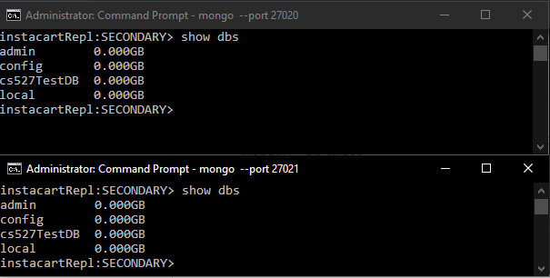
Check Replication

Slide 17
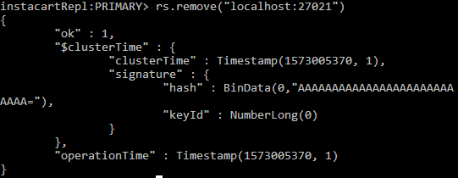
3. Remove members - rs.remove()

Slide 18
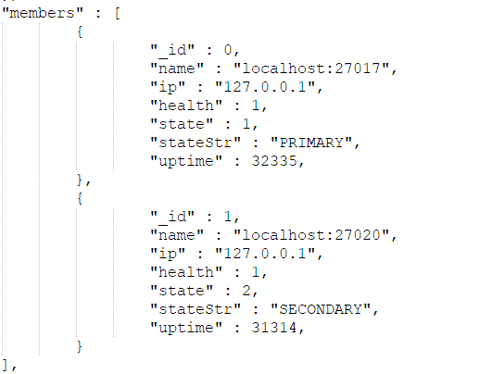
4. Checking status

Slide 19
Thank you.
Any questions?

